Slide 2
PrEP scale up and STI management in Brazil
Valdilea G. Veloso
@Valdilea
Share your thoughts on this presentation with #IAS2019
Notes:
Good afternoon.
I am Valdilea Veloso and it is my great pleasure to present to you initial results of the ImPrEP Study, a demonstration project of same day PrEP initiation among MSM and TGW in Brazil, Mexico and Peru.
. In particular, I will be presenting data on safety, early continuation, adherence and HIV incidence. This study is being funded by Unitaid with the support of each country Ministry of Health.

Slide 3
Conflict of Interest Disclosure
I have no conflit of interest to report.

Slide 4
National PrEP Guideline (PCDT PrEP)
Developed by a special committee of scientific experts and civil society.
National Commission for Technology Incorporation (CONITEC) has recommended the inclusion of PrEP + ANVISA regulatory approval of TDF+FTC (Gilead) in May 2017.
The priority target for PrEP are key populations, which concentrate the highest prevalence of HIV in the country:
Gays and other MSM;
Trans people;
Sex workers,
Serodiscordant couples
www.aids.gov.br/pcdt
The Brazilian guideline offers daily dosing of TDF+FTC.

Slide 5
PrEP Guideline App

Slide 6
Distribution of PrEP Services in Brasil
- By June 2019: 196 PrEP services
(*) tiveram pelo menos uma dispensação no período analisado
Dados de jan a dez de 2018

Slide 7
Updated Guidelines for STI

Slide 8
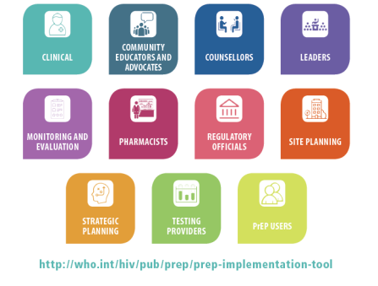
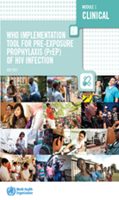
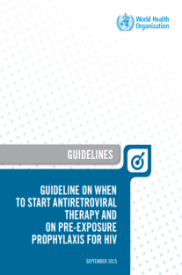
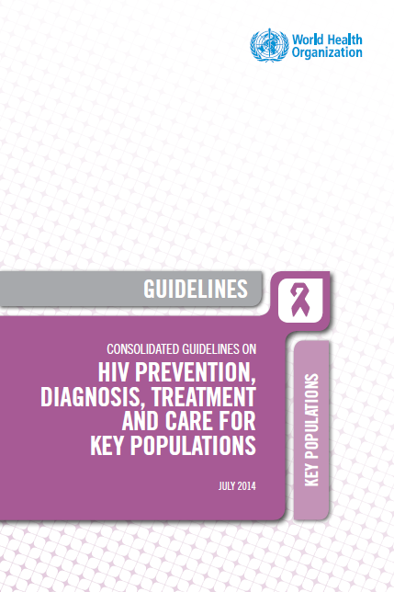
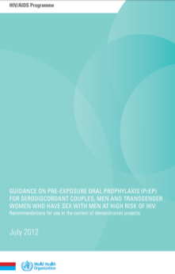
WHO on HIV Pre-exposure prophylaxis (PrEP)
2018
WHO PrEP implementation tool. Update on adolescents and M&E.
2017
PrEP drugs oEML
(TDF/FTC; TDF/3TC; TDF);
WHO PrEP Implementation tool
Global PrEP Coalition
2015
PrEP for people at substantial HIV risk (≈3 per 100 person years) (strong recommendation)
2014
PrEP for MSM
(strong recommendation) Other KP (conditional)
WHO PrEP implementation tool – an enabling document
2012
PrEP for SDC, MSM and TG in the context of demo projects (conditional recommendation)
http://www.who.int/hiv/pub/prep/en/
Notes:
Despite the concentrated epidemic among key populations predominantly MSM and TGW, Pre-exposure prophylaxis (PrEP) implementation in the region has been very limited

Slide 9
Implementação da Profilaxia Pré-Exposição ao HIV Um projeto de demonstração- PrEP Brasil

Slide 10
Incidence of Syphilis over 96 weeks of follow-up
Overall
Young (18-24 years)
Transgender women
30
20
16.7
(per 100 person years)
Incidence
10
8.1
6.2
0
Upper limit
10.5
11.2
35.0
Lower limit
6.2
3.4
8.0

Slide 11
Prevalence of Chlamydia and Gonorrhea over 96 weeks of follow-up
Overall
Young (18-24 years)
Transgender women
30
20
20
(per 100 participants)
14.29
Prevalence
12.5
12.39
Week
9.38
10.6
10
8
7.73
7.5
7.61
Baseline (n = 450)
6.79
6.67
48 (n = 375)
4.89
3.73
4.35
4
4.76
96 (n = 280)
0
0
Chlamydia
Gonorrhea
Chlamydia
Gonorrhea
Chlamydia
Gonorrhea
Upper limit
10.5
10.4
9.7
6.9
5.7
10.6
18.5
13.0
16.5
16.3
8.5
20.6
11.7
29.2
19.3
0.0
13.9
40.2
Lower limit
5.5
5.0
3.8
2.9
1.8
4.4
6.3
2.2
2.2
4.9
0.2
4.4
0.0
0.0
0.0
0.0
0.0
0.0
p = 0.58
p = 0.22
p = 0.40
p = 0.93
p = 0.58
p = 0.22

Slide 12
Prevalence of Chlamydia, Gonorrhea and Syphilis at baseline
Chlamidya
Gonorrhea
Syphilis
30
22.1
20
(per 100 participants)
Prevalence
10
8.3
6.6
0
Upper limit
13.2
11.0
29.2
Lower limit
3.4
2.2
14.8

Slide 13
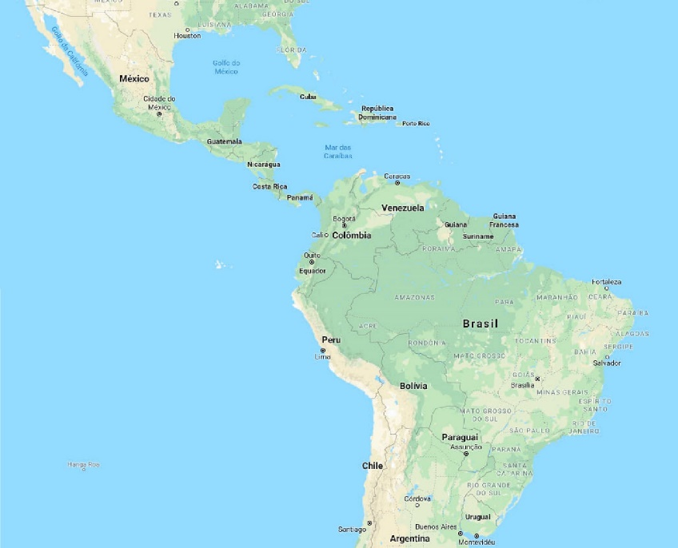
PrEParedness for the Rollout of Effective HIV Prevention among Key Affected Populations in Brazil, Peru and Mexico
Objective: assess uptake, acceptability and feasibility of same day PrEP (TDF/FTC orally once a day) for MSM and TGW in the context of HIV combination prevention.
Design: multi-site prospective, open-label demonstration study.
Countries: Brazil (Fiocruz - Coordination), Peru and Mexico.
Population: 7500 MSM/TGW (Brazil: 3,000; Mexico: 3,000; Peru: 1,500).
Sites: Public Health services and NGOs.
Regional Exchange Platform on PrEP
Working Group on Drug Licensing and Costing
Substudies (seroincidence, economic and mathematical modelling studies, etc).
Brazil: 14 sites in 12 cities
Mexico: 6 sites in 3 cities
Peru: 10 sites in 7 cities
Notes:
Eligible participants were HIV uninfected MSM and TGW ≥18 years old at high risk for HIV infection . Participants were screened and enrolled on the same day at 15 sites in Brasil 8 sites in Mexico and 10 sites in Peru and received a 30 days’ supply of TDF/FTC.

Slide 14
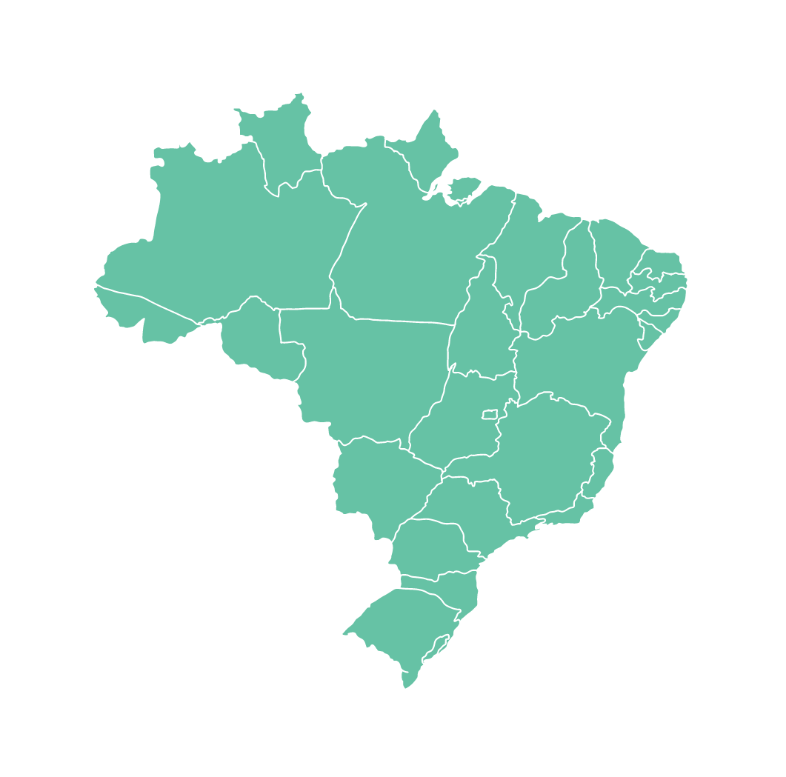
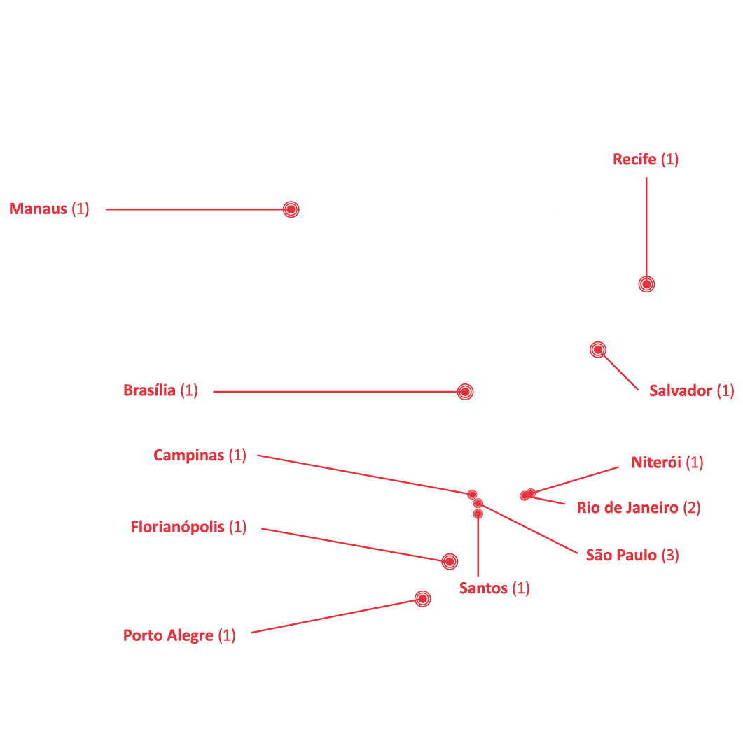
Brazil – 14 sites in 12 cities
Notes:
Eligible participants were HIV uninfected MSM and TGW ≥18 years old at high risk for HIV infection . Participants were screened and enrolled on the same day at 15 sites in Brasil 8 sites in Mexico and 10 sites in Peru and received a 30 days’ supply of TDF/FTC.

Slide 15
Sexually Transmitted Infections at enrollment
Overall
MSM
Transgender women
30
20.7
20
17.0
(per 100 participants)
Prevalence
11.5
11.1
12.2
10
10
9.3
7.4
7.0
0
Chlamydia
Ghonorrhea
Syphilis
Chlamydia
Ghonorrhea
Syphilis
Chlamydia
Ghonorrhea
Syphilis
Upper limit
12.4
8.1
10.8
12.1
7.8
10.1
21.3
16.0
25.3
Lower limit
10.6
6.6
9.2
10.2
6.3
8.4
12.7
8.4
16.1

Slide 16
Tests Methodologies for STI Screening and diagnosis
- Molecular tests for Chlamydia & Gonococcus are not yet avaliable for routine care
- HIV Rapid test (3rd Generation)
- Syphilis Rapid Test

Slide 17
Sampling Sites for Scale Up of Molecular STI Screening
Commercial kits are validated for urine samples, not for rectal or orofaringe
Would we have regulatory implications if rectal or oral sampling be recommended as standard of care in Brazil ?

Slide 18
Rapid tests challenges in the Context of PrEP
Syphilis
HIV Rapid Test

Slide 19
Sampling Sites for Scale Up of Molecular STI Screening
WHO will recommend multiple sites sampling ?

Slide 20
What is the best frequency of screening for Chlamydia & gonococcus ?

Slide 21
Frequency of STI Screening

Slide 22
Sampling Sites
Missing diagnosis with urine sampling only
Gonococcus Infection | n | %
Urine - | 437
Rectal Swab + | 31 | 7,10%
Orofaringeal + | 13 | 3,00%
Oro or Rectal Swabs + | 44 | 10,10%
Chlamydia Infection
Urine - | 432
Rectal Swab + | 52 | 12,00%
Orofaringeal + | 5 | 1,20%
Oro or Rectal Swabs + | 57 | 13,20%

Slide 23
Central laoratories for STI Molecular diagnosis
A central laboratory (LACEN) is vailable in each one of the 27Brazilian States.
The laboratory will be the referal laboratories for STI screening

Slide 24
PrEP expansion in Brazil
The Ministry of Health has already secured funds to expand PrEP services building on VCTs Units, that will provide the full services involved in HIV Combination Prevention
The definiton of Sampling and Frequency will be essential to plan for adequate estructure and procedures definitions

Slide 25
Acknowledgments
PrEP Brasil, PreParadas and ImPrEP teams
Study participants
Thanks to our sponsors

Slide 26
Thank You !

